Slide 1


Life in Agile
Adapting to a new culture of communication

Slide 2
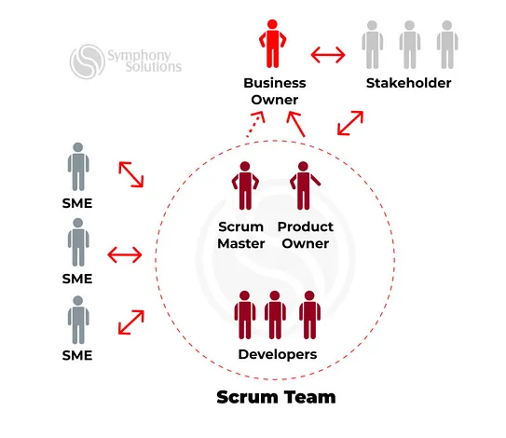
The scrum-agile team
Product Owner
Scrum Master
Development team
Developers
Testers

Slide 3
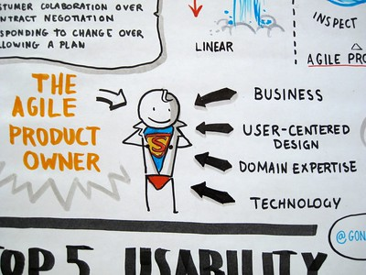
Product owner
Creates User Stories
Interviews the client to get the pain points of the project
Asks “As a(n) X, I want Y so that Z” questions.
Asks the 5 Whys
Manages the product and product backlog
Involves the stakeholders/end-users in backlog refinement/management
Aligns with other product owners from the product, company, or customer perspective

Slide 4
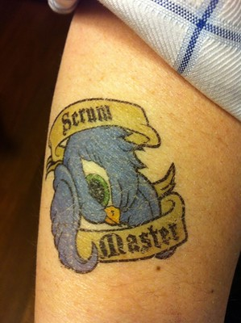
Scrum master
Facilitator
Coaches the Scrum Team on Scrum practices
Manages roadblocks
Encourages open communication and collaboration among team members, stakeholders, and other teams
Fosters trust and empower the team to self-organize
Continuous improvement of the team
Works closely with the Product Owner for effective prioritization of work and the product backlog

Slide 5
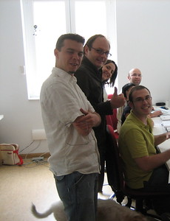
Developers and testers
Acts as a self-organizing unit
All team members are at the same ‘level’, no special titles, no ‘sub-teams’
Cross-functional, have all the skills necessary to develop the product
Committed to achieving the common sprint goal

Slide 6
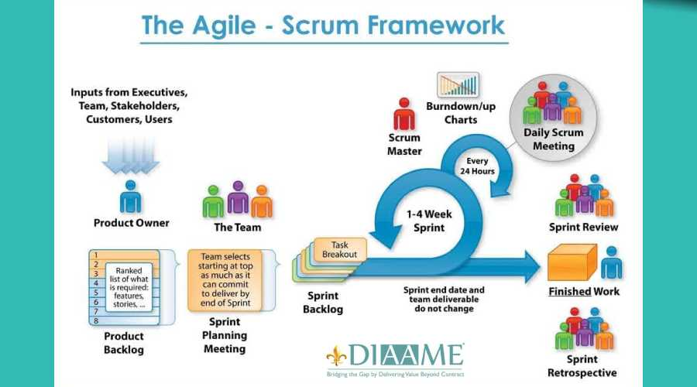

Slide 7
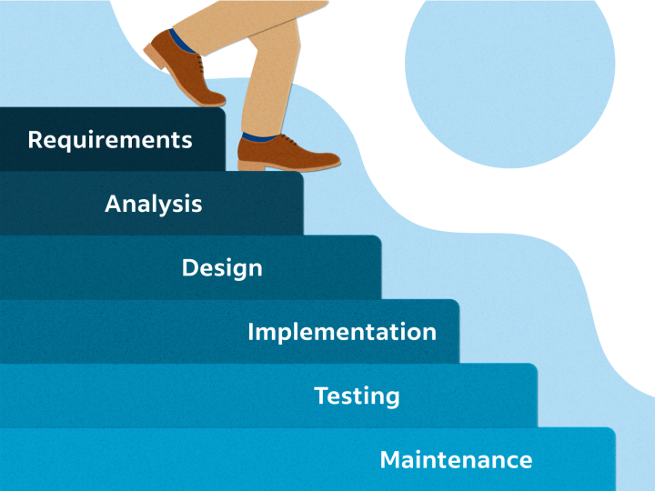
Waterfall project development approach

Slide 8


Waterfall vs agile approaches
Waterfall
Agile
Linear approach
One step completes before the next starts
All requirements at the start
Rigid
Little communications during project with clients
Hard to adjust requirements mid-project
Risks identified and addressed early in project
Some may be missed until too late
Iterative and Incremental approach
Each small step builds on the previous
Requirements are updated along the whole project
Client involvement throughout the process is welcomed
Flexibility to adjust requirements mid-project
Risks identified during in project
Early detection allows them to be addressed as they come up
Larger issues may be harder to adapt

Slide 9

SNHU Travel project
Example of the Agile Approach
Mid-way through this project, the client came to the Product Owner with a major change to how the product would operate
Due to the iterative process of agile, the team was able to adjust in the middle of a Sprint to accommodate the change.
Using the Agile approach was the correct choice for this project

Slide 10

References
Do, M. (2023, July 14). Scrum master & product owner: Their relationship in product development. Medium. https://medium.com/@malik.do/scrum-master-product-owner-their-relationship-in-product-development-84a57885fa0f
Jovanović , V. (2023, August 9). 5 tips for scrum masters: Collaborating with Project Management for success in a transforming landscape. Scrum.org. https://www.scrum.org/resources/blog/5-tips-scrum-masters-collaborating-project-management-success-transforming-landscape
Palmquist, K. (2023, July 1). Waterfall Project Management: Definition and examples - indeed. Waterfall Project Management: Definition and Examples. https://www.indeed.com/career-advice/career-development/waterfall-project-management
Images in slides 2-6 & 8 used from Creative Commons

